Slide 1

Digital Image Processing Case Study
Title: Animal Identification Using Matlab Simulink
Mentor: Mr. Mrugendra Vasmatkar
Group members:
Vinaya Nair (D14B/48)
Sakshi Singh (D14B/65)
Yukta Talagana (D14B/66)
Prasiddhi Tembulkar (D14B/67)

Slide 2
Problem Statement
Due to increasing animal thefts , it becomes necessary to keep an identification of animals as per the owner’s requirement.
Historically animal ID was put into use.
Animal identification is the basis for keeping accurate production records of the herd/flock.
It is also used for training machines in artificial intelligence and machine learning.

Slide 3
Proposed Solution
Object recognition is a computer vision technique for identifying objects in images or videos.
Object recognition is a key output of deep learning and machine learning algorithms.
The goal is to teach a computer to do what comes naturally to humans: to gain a level of understanding of what an image contains.

Slide 4
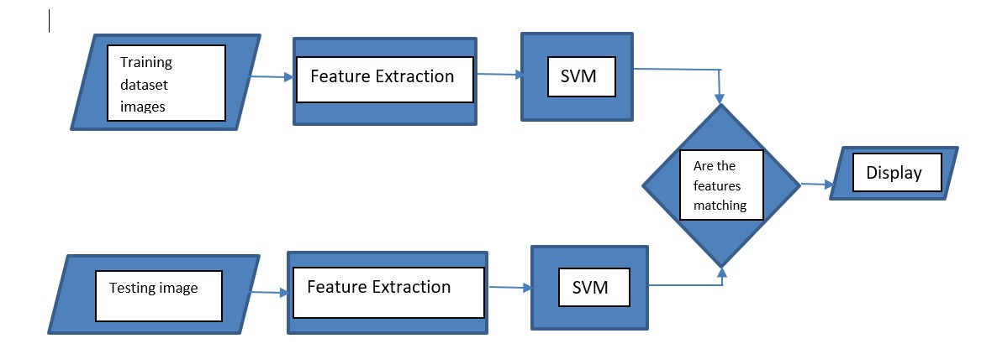
Flowchart of proposed project

Slide 5
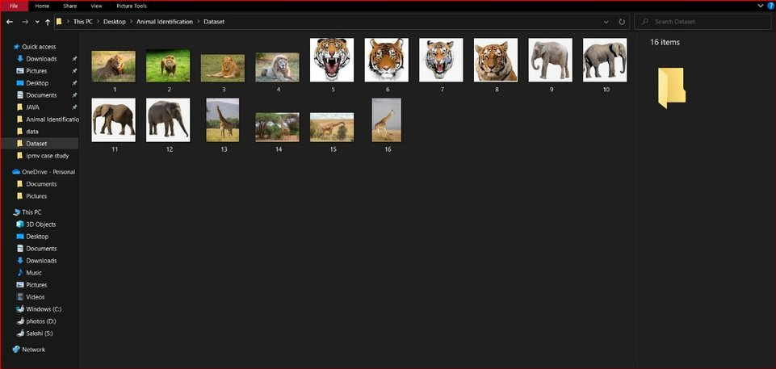
Training dataset

Slide 6
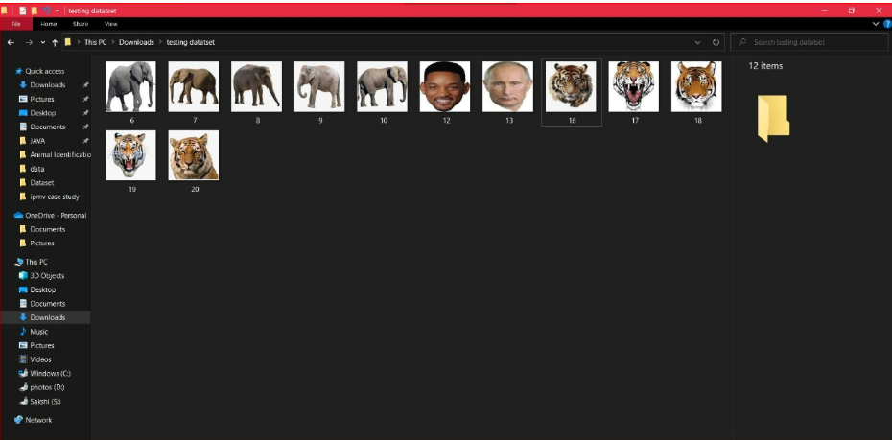
Testing dataset

Slide 7
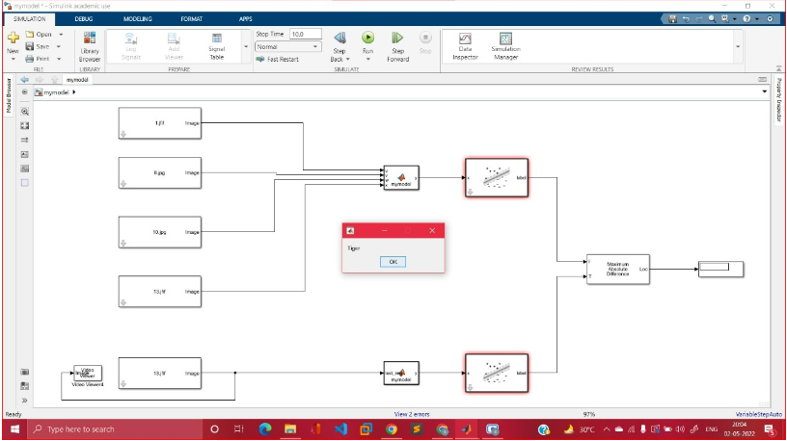
Implementation Of Project In Matlab Simulink

Slide 8
Conclusion
Thus we have implemented the animal identification using Matlab Simulink. Here, we have identified various animals using the training and testing data.

